Slide 1
LAZY FRIDAY
Team Members:
Josh Durica
Luis Guan
Jimmy Tran
Kenneth Troughton
Jason Yip

Slide 2
An android app for the masses
Have you ever wanted to control your desktop through your mobile device?
Have you ever wanted to write a document, email, or browse the internet without typing anything?
Have you ever wanted to launch your favorite applications and games on your desktop with a single button press?
Have you ever wanted to do any of the above from anywhere?

Slide 3
Lazy Friday!
Phone application dedicated to making your life easier (edit: lazier)
Desktop based application that grabs the host’s IP address and allows a mobile device to connect wirelessly through a wireless internet connection
Use your phone as a wireless mouse and keyboard utilizing all of the control that’s included in those input devices

Slide 4
Features
Control your pc via your android phone
Use speech recognition to transcribe documents, write emails, and browse the internet
Launch executable files with the touch of a button
Create your own macros and macro profile to customize your phone’s interaction with your desktop
Upload a text document with the path of each executable file you want to macro for unlimited macros

Slide 5
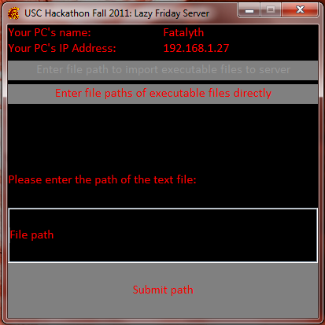
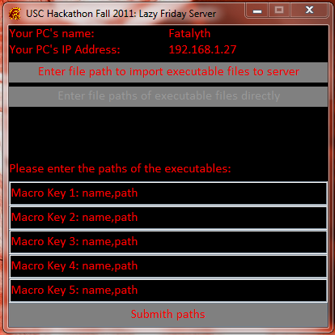
Server Interface
Two options to set up macros:
Parsing a .txt file with a list of the executable paths
Parsing the paths directly into the server interface

Slide 6
Client Interface

Slide 7
Remotus
Opens a socket connection between mobile phone and computer
Gives the user control of the mouse via simple track pad
Lets user type on computer using phone’s keyboard

Slide 8
What we did
Overhauled UI
Enhanced mouse track pad, adding buttons and multi-touch capabilities
Augmented keyboard controls to support complex macros and symbols/ASCII keys not supported on Android keyboards
Streamlined voice recognition system

